Slide 1
Jquery DOM Manipulation
By:parul madan(AP)
Computer Science

Slide 2
jQuery DOM Manipulation
jQuery comes with a bunch of DOM related methods that make it easy to access and manipulate elements and attributes.
Get Content - text(), html(), and val()
text() - Sets or returns the text content of selected elements
html() - Sets or returns the content of selected elements (including HTML markup)
val() - Sets or returns the value of form fields.
Syntax:
$("#btn1").click(function(){ alert("Text: " + $("#test").text()); }); $("#btn2").click(function(){ alert("HTML: " + $("#test").html()); });
$("#btn3").click(function(){ alert("HTML: " + $("#test1").val()); });
<p id="test">This is some <b>bold</b> text in a paragraph.</p>
<p >Name: <input type="text" id="geu" value="Mickey Mouse"></p>

Slide 3
Get Attributes - attr()
The jQuery attr() method is used to get attribute values.
For eg:
$(document).ready(function(){
$("button").click(function(){
alert($("#w3s").attr("href"));
});
});
<p><a href="www.google.com" id="w3s">google.com</a></p>

Slide 4
Set Content - text(), html(), and val()
$("#btn1").click(function(){ $("#test1").text("Hello world!"); }); $("#btn2").click(function(){ $("#test2").html("<b>Hello world!</b>"); }); $("#btn3").click(function(){ $("#test3").val("Dolly Duck"); });

Slide 5
A Callback Function for text(), html(), and val()
All of the three jQuery methods : text(), html(), and val(), also come with a callback function.
The callback function has two parameters:
the index of the current element in the list of elements selected and the original (old) value.
You then return the string you wish to use as the new value from the function.
For eg:
<button id="btn1">Show Old/New Text</button>
$("#btn1").click(function(){ $("#test1").text(function(i, origText){ return "Old text: " + origText + " New text: Hello world! (index: " + i + ")"; }); });

Slide 6
Set Attributes - attr()
The jQuery attr() method is also used to set/change attribute values.
For eg:
$(document).ready(function(){
$("button").click(function(){
$("#w3s").attr("href", "https://www.geu.ac.in");
});
});
<p><a href="https://www.google.com" id="w3s">google_page</a></p>

Slide 7
A Callback Function for attr()
The callback function has two parameters:
the index of the current element in the list of elements selected and the original (old) attribute value.
You then return the string you wish to use as the new attribute value from the function.
Eg: <script>
$(document).ready(function(){
$("button").click(function(){
$("#w3s").attr("href", function(i, origValue){
return origValue + "/drive/";
});
});
});
</script>
<p><a href="https://www.google.com" id="w3s">google_page</a></p>

Slide 8
jQuery - Add Elements
append() - Inserts content at the end of the selected elements
prepend() - Inserts content at the beginning of the selected elements
after() - Inserts content after the selected elements
before() - Inserts content before the selected elements

Slide 9
jQuery append() Method
$(document).ready(function(){
$("#btn1").click(function(){
$("p").append(" <b>Appended text</b>.");
});
$("#btn2").click(function(){
$("ol").append("<li>Appended item</li>");
});
});
</script>

Slide 10
jQuery - Remove Elements
remove() - Removes the selected element (and its child elements)
empty() - Removes the child elements from the selected element
For eg:
<div id="div1" style="height:100px;width:300px;border:1px solid black;background-color:yellow;">
This is some text in the div.
<p>This is a paragraph in the div.</p>
<p>This is another paragraph in the div.</p>
</div>
<script>
$(document).ready(function(){
$("button").click(function(){
$("#div1").remove();
});
});
</script>

Slide 11
Filter elements to be removed
<p>This is a paragraph.</p>
<p class="test">This is another paragraph.</p>
<p class="test">This is another paragraph.</p>
<p class="demo">This is p element with class="demo".</p>
<script>
$(document).ready(function(){
$("button").click(function(){
$("p").remove(".test,.demo");
});
});
</script>

Slide 12
jQuery Manipulating CSS
addClass() - Adds one or more classes to the selected elements
removeClass() - Removes one or more classes from the selected elements
toggleClass() - Toggles between adding/removing classes from the selected elements
css() - Sets or returns the style attribute

Slide 13
jQuery addClass() Method
.important {
font-weight: bold;
font-size: xx-large;
}
.blue {
color: blue;
}
<h1>Heading 1</h1>
<h2>Heading 2</h2>
<p>This is a paragraph.</p>
<p>This is another paragraph.</p>
<div>This is some important text!</div><br>
<script>
$(document).ready(function(){
$("button").click(function(){
$("h1, h2, p").addClass("blue");
$("div").addClass("important");
});
});
</script>

Slide 14
jQuery css() Method
To return the value of a specified CSS property, use the following syntax:
Syntax:
$("p").css("background-color");
To set a specified CSS property, use the following syntax:
$("p").css("background-color", "yellow");
To set multiple CSS properties, use the following syntax:
$("p").css({"background-color": "yellow", "font-size": "200%"});

Slide 15
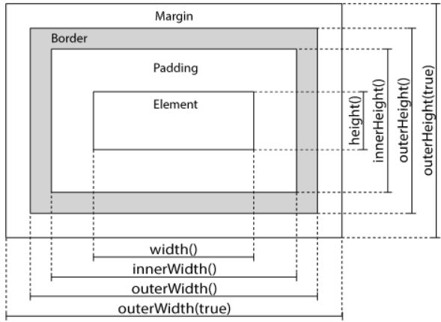
jQuery Dimension Methods
width()
height()
innerWidth()
innerHeight()
outerWidth()
outerHeight()

Slide 16
For eg:
<script>
$(document).ready(function(){
$("button").click(function(){
var txt = "";
txt += "Width of div: " + $("#div1").width() + "</br>";
txt += "Height of div: " + $("#div1").height() + "</br>";
txt += "Outer width of div (margin included): " + $("#div1").outerWidth(true) + "</br>";
txt += "Outer height of div (margin included): " + $("#div1").outerHeight(true);
$("#div1").html(txt);
});
});
</script>
#div1 {
height: 100px;
width: 300px;
padding: 10px;
margin: 3px;
border: 1px solid blue;
background-color: lightblue;
}

